Slide 1
NumPy

Slide 2
Overview
NumPy stands for Numerical Python, and it is a fundamental library for numerical computing in Python.
Designed for efficient computation with large, multi-dimensional arrays and matrices (~50x faster than python list)
Offers a wide range of mathematical functions to perform operations on these arrays.
Widely used in scientific, engineering, and data analysis applications.
Installation: PyCharm > Python Packages > numpy
import numpy as np

Slide 3
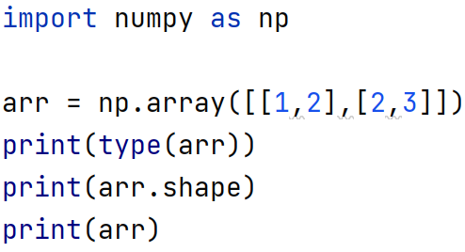
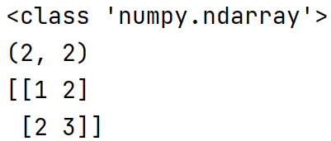
Arrays: ndarray
The ndarray type is a mutable container
All elements must be of the same type / homogenous
An ndarray object is called an array and is created by the array() function
An array may have zero, one, or many dimensions

Slide 4
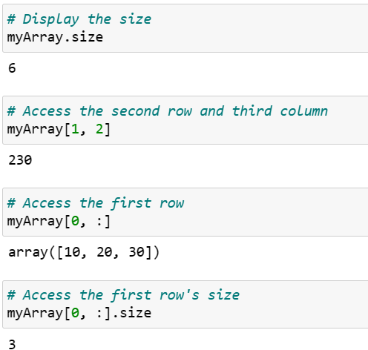

Slide 5
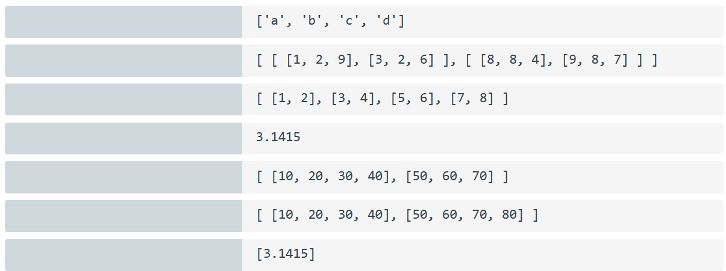
(4)
(2,2,3)
(4,2)
()
Invalid
(2,4)
(1)

Slide 6
Array functions – array()
arr = np.array([[1,2],[2,3]])

Slide 7
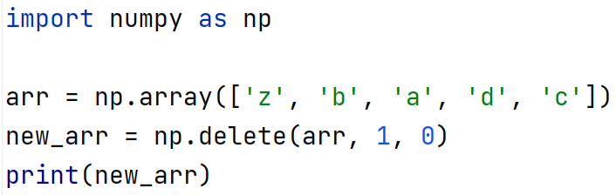

Array functions – delete()

Slide 8
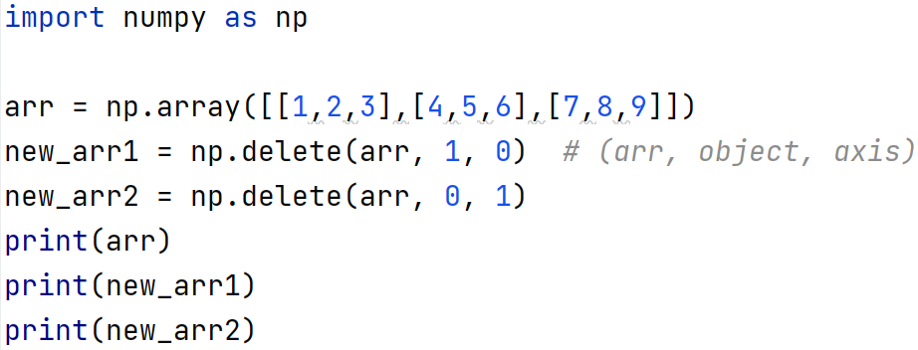
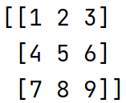
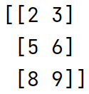

Array functions – delete()

Slide 9

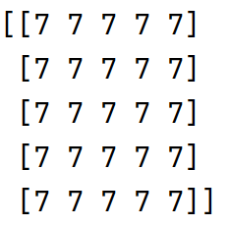
Array functions – full()

Slide 10
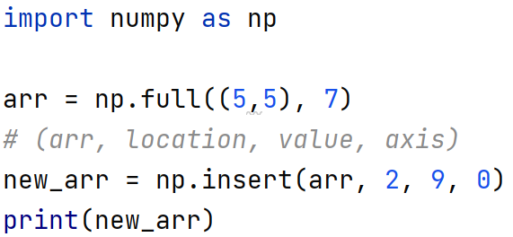
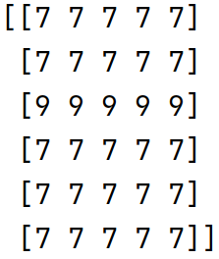
Array functions – insert() a new row

Slide 11
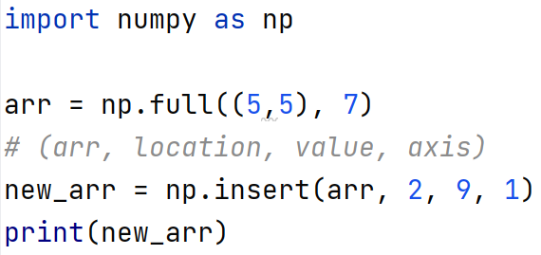
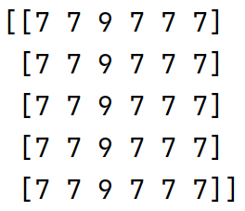
Array functions – insert() a new column

Slide 12
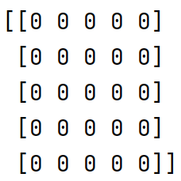
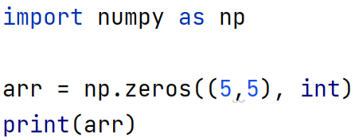
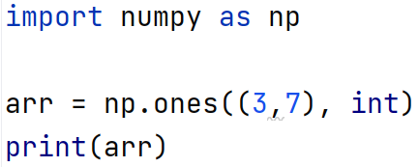
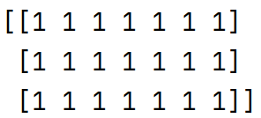
Array functions – zeros() and ones()

Slide 13
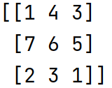
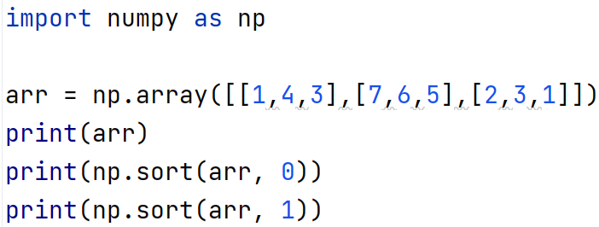
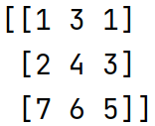
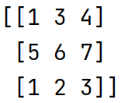
Array functions – sort()

Slide 14
Shape functions
Occasionally, data scientists must change the shape of an array
Reshaping an array changes array dimensions while retaining array data
Ex: [[1, 3, 5], [2, 4, 6]] might be reshaped to [[1, 2], [3, 4], [5, 6]]
Flattening an array reshapes an N-dimensional array to one dimension
Example: [[1, 3, 5], [2, 4, 6]] > [1, 2, 3, 4, 5, 6]

Slide 15
Shape functions: element order
Row-major order prioritizes row order
1 | 3 | 5
2 | 4 | 6
1 | 3 | 5 | 2 | 4 | 6
Column-major order prioritizes column order
1 | 3 | 5
2 | 4 | 6
1 | 2 | 3 | 4 | 5 | 6

Slide 16
Shape functions: element order
Some shape functions have an order parameter
order='C' specifies row-major order
order='F' specifies column-major order

Slide 17
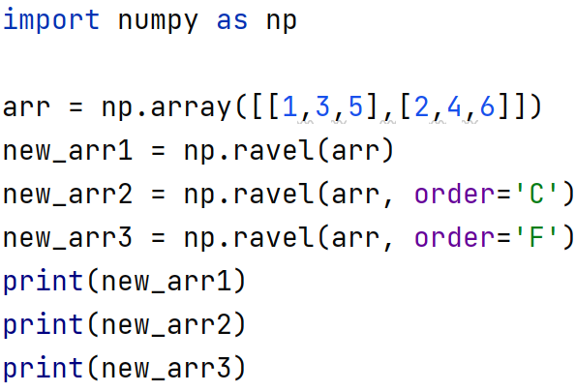
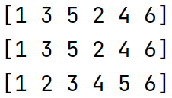
Shape functions: ravel()
Returns a flattened array

Slide 18
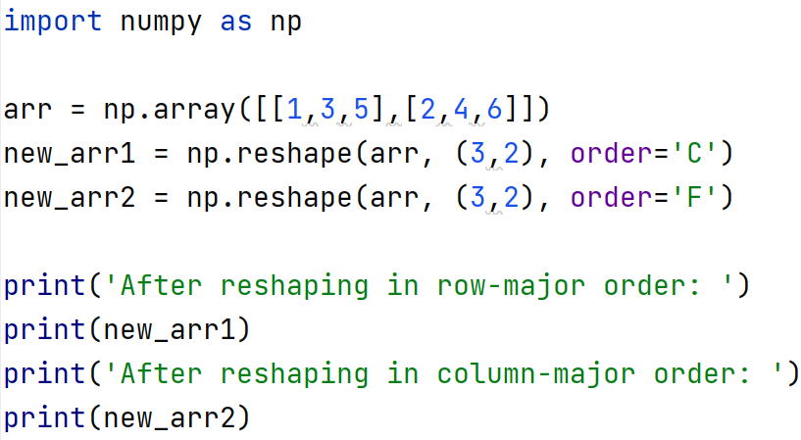
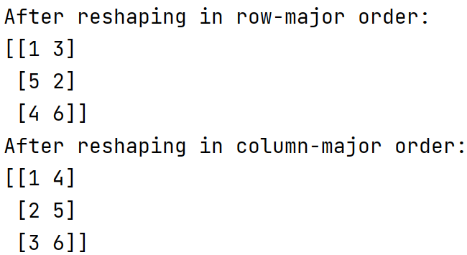
Shape functions: reshape()
Returns a reshaped array
M x N == A x B (#items)

Slide 19
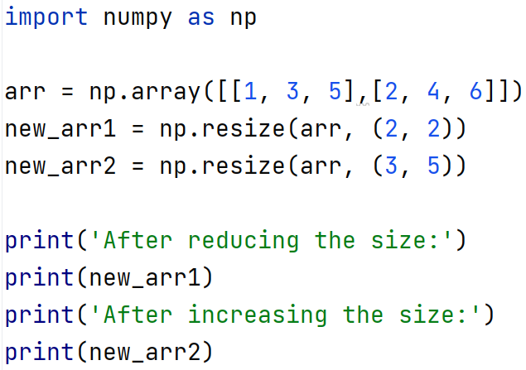
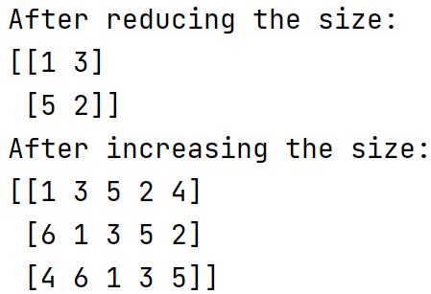
Shape functions: resize()
Returns a resized array
M x N == A x B (# of items)
M x N != A x B (# of items)

Slide 20
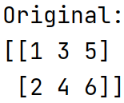
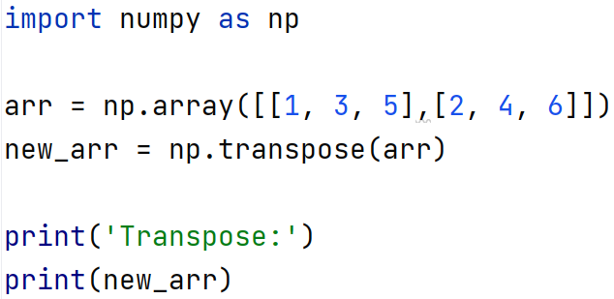
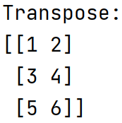
Shape functions: transpose()
The rows of the original matrix become the columns of the transposed matrix, and vice versa.

Slide 21
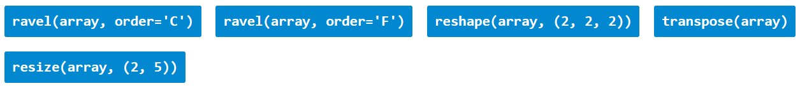
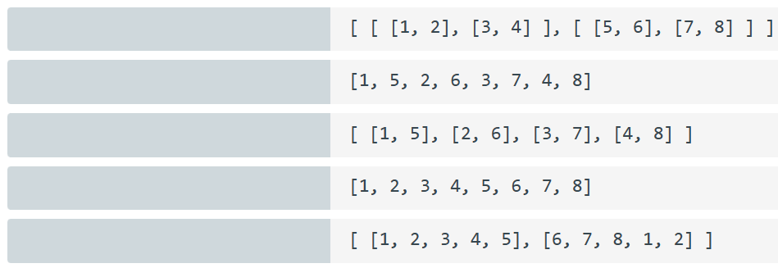



Exercise
1 | 2 | 3 | 4
5 | 6 | 7 | 8

Slide 22
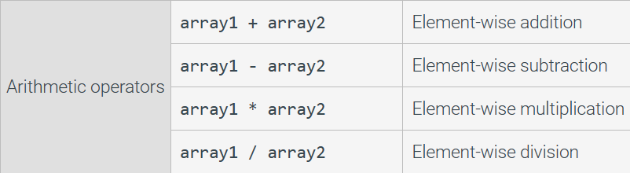
Math operators and functions
NumPy offers a rich library of mathematical operators and functions.

Slide 23
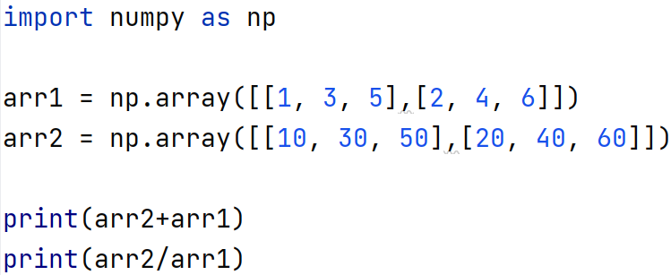



Slide 24
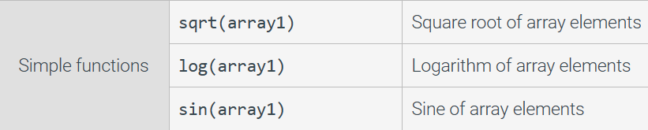
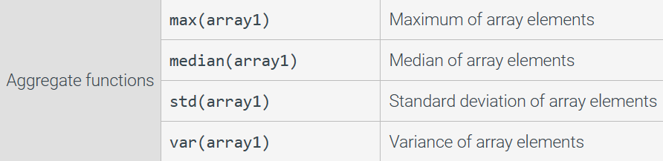

Slide 25
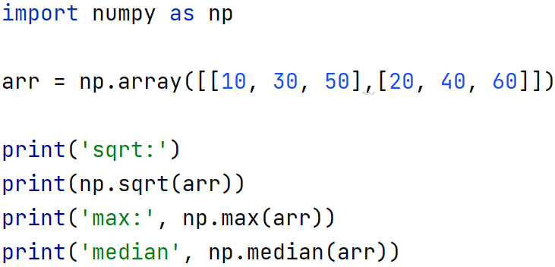



Slide 26
ZyBook Reading:
31.5 NumPy package

